Slide 1


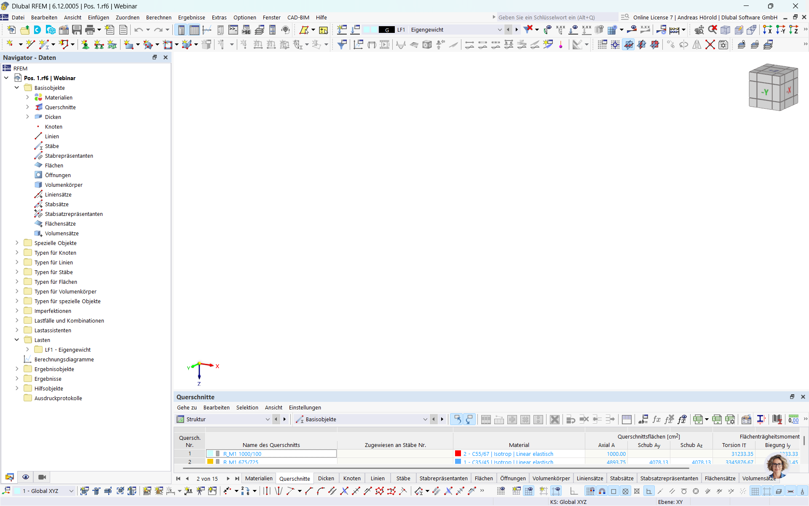
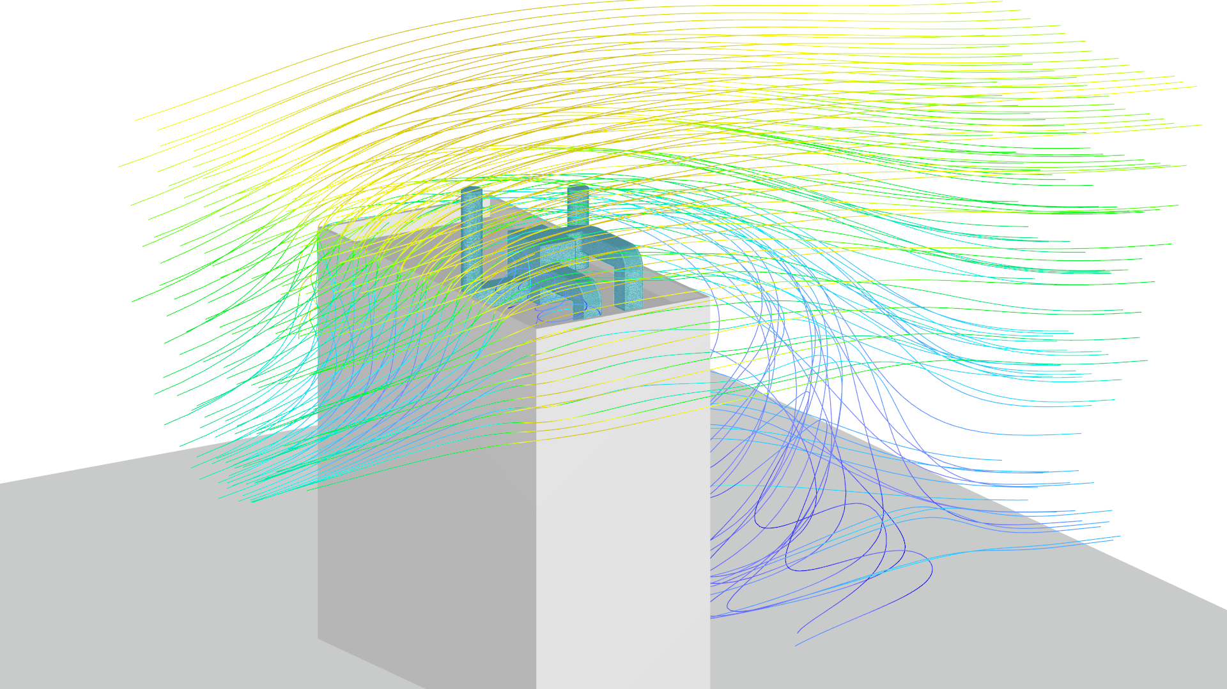

Webinar
Wind Load Determination for Rooftop Equipment
www.dlubal.com
RFEM

Slide 2



Today with
Dipl.-Ing. (FH)
Andreas Hörold
Clemens Gutmann, M.Eng.
Organizer
Co-Organizer ​
Marketing & Public Relations​
Dlubal Software GmbH​
Product Engineering & Customer Support​
Dlubal Software GmbH​

Slide 3
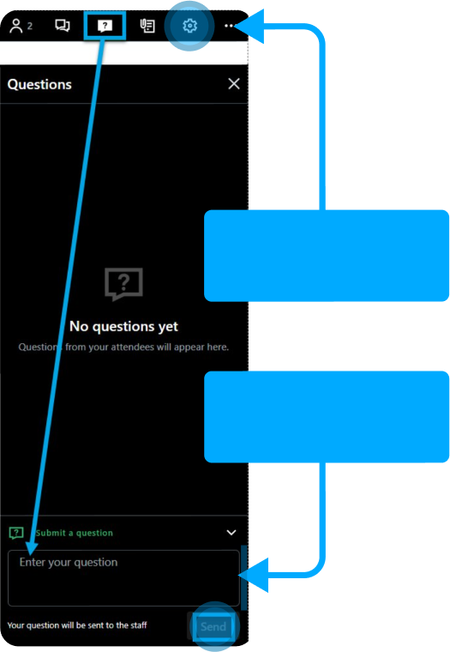



Questions During the Presentation​
1
Adjust
audio settings
2
or
Webinar Control
Panel Desktop
info@dlubal.com
Ask question
Webinar

Slide 4


Content
1
Variant study: roof ventilation system
2
Mesh settings
3
Analysis settings
4
Result evaluation
Webinar

Slide 5
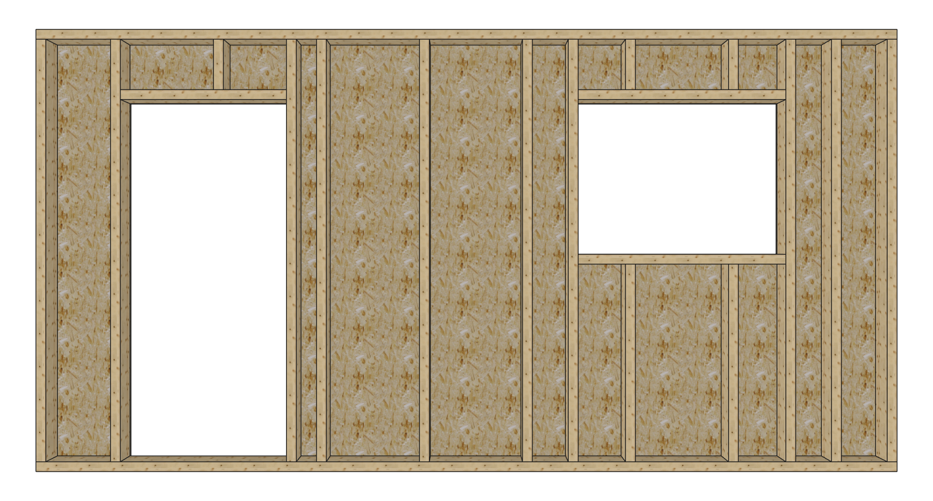
Theoretische Grundlagen
Aufbau einer Holztafelwand:
Kopfrippe
Sturzrippe
Fensteröffnung
Randrippe
Innenrippe
Türöffnung
Brüstungsrippe
Beplankung
Fußrippe
Webinar

Slide 6


Ausblick
Bemessung der Balkenscheibe nach US Norm (SDPWS)
Unterschiedliche Verbindungsmittelabstände innerhalb einer Fläche
Wand-Wand Anschlüsse
Wand-Decken Anschlüsse
Benutzerdefinierte Rippenanordnung
Grafische Ergebnisdarstellung der Balkenscheibenfläche
Giebelwandscheiben (Dreieck)
Definition und Bemessung von Schub- und Zugankern (Add-On Komponenten)
Weitere Webinare zum Thema Holztafelbau (Aussteifungsberechung Wände und Decken)
Webinar

Slide 7







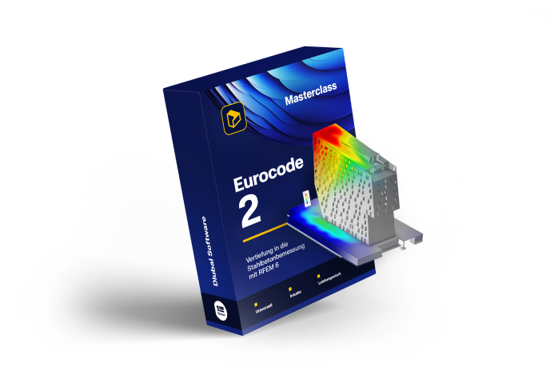
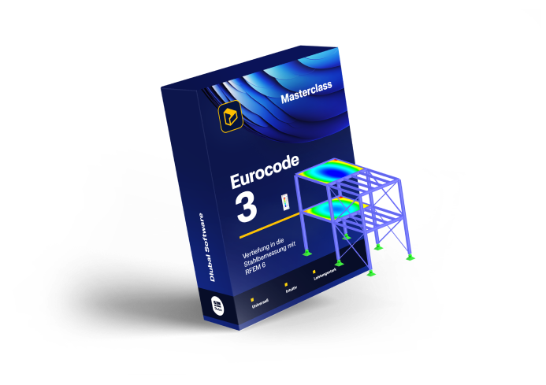



Online Courses
RFEM⁶
Masterclass
Eurocode 2
Masterclass
Eurocode 3
Masterclass
All you need to know for a start!
Dive in Reinforced Concrete Design with RFEM 6!
Deep Dive in Steel Design with RFEM 6!
Go to course
Go to course
Go to course

Slide 8

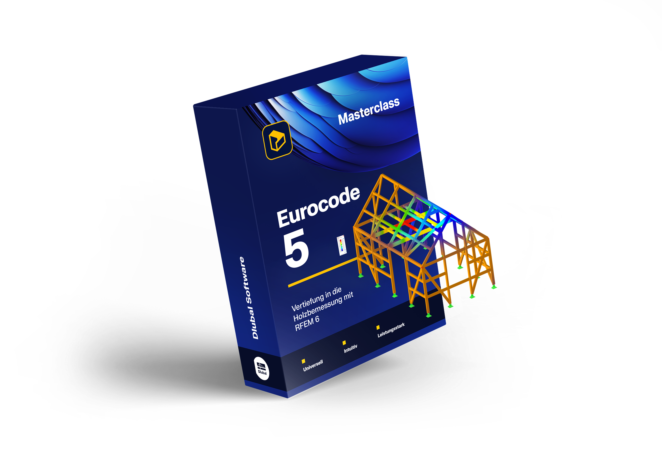



Online Courses
Eurocode 5
Masterclass
Eurocode 8
Masterclass
Deep Dive in Timber Design
with RFEM 6!
Deep Dive into Earthquake Design with RFEM 6!
Go to course
Go to course

Slide 9









Submit your customer
project and receive
a free online course!
For each published project, you will receive a voucher for an Online Course on RFEM 6, Eurocode 2, Eurocode 3, Eurocode 5, or Eurocode 8, valued at 199 - 399€.
Submit your Project

Slide 10










Free Online Services
DLUBAL COMMUNITY
90-Day Full Trial Version Download
GEO ZONE TOOL
Experience the full power of our structural analysis and design software with a free 90-day trial. Get access to all programs and add-ons without restrictions.
CROSS-SECTION PROPERTIES
3D MODELS TO DOWNLOAD
Explore All Our Services

Slide 11






Get Further Details
About Dlubal​
Videos and recorded webinars
Newsletters
Events and conferences
Knowledge Base Articles
90-Day
MIA AI Assistent
Download 90-Day Full Trial Version
Full Free Trial
www.dlubal.com
Dlubal Software GmbH​
Am Zellweg 2
93464 Tiefenbach, Germany
+49 9673 9203-0​
info@dlubal.com​
Visit www.dlubal.com

Slide 12

Thank You for Your
Attention
Webinar

