Slide 1
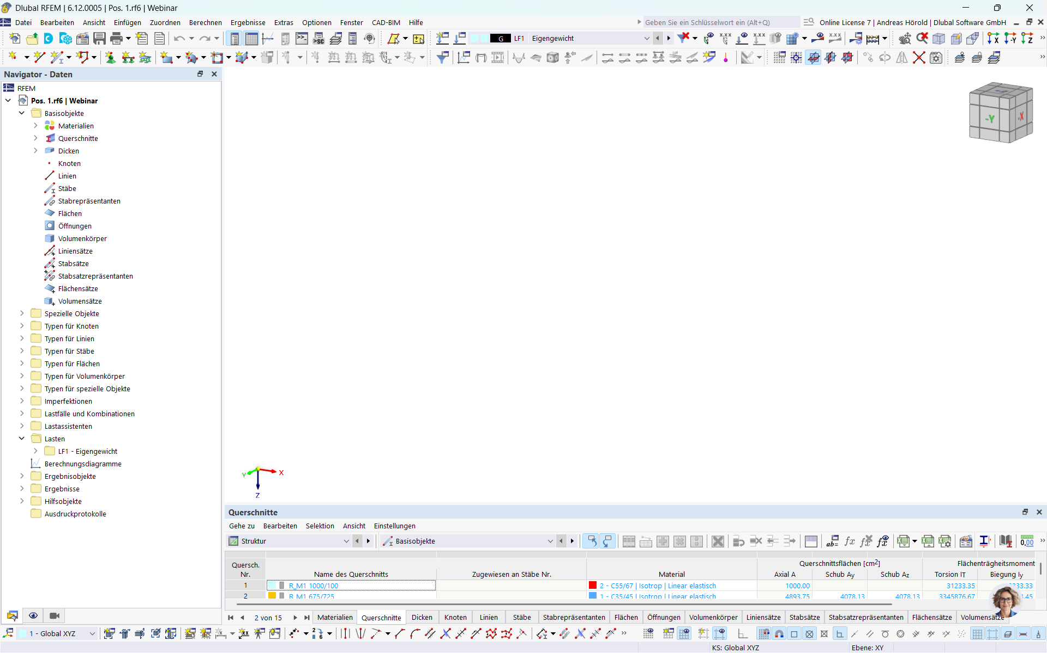
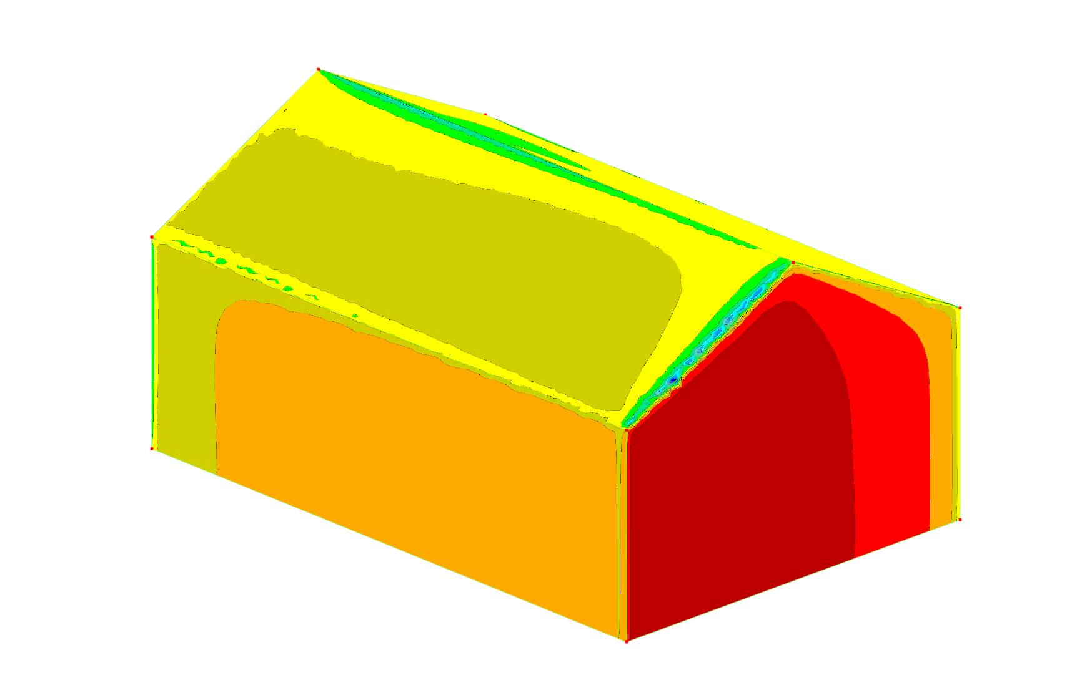
Webinar
Determining Wind Loads on Small Buildings
www.dlubal.com
RFEM

Slide 2


Today with
Dipl.-Ing. (FH)
Andreas Hörold
Clemens Gutmann, M.Eng.
Organizer
Co-Organizer ​
Marketing & Public Relations​
Dlubal Software GmbH​
Deputy Head of Product Engineering
Dlubal Software GmbH​

Slide 3
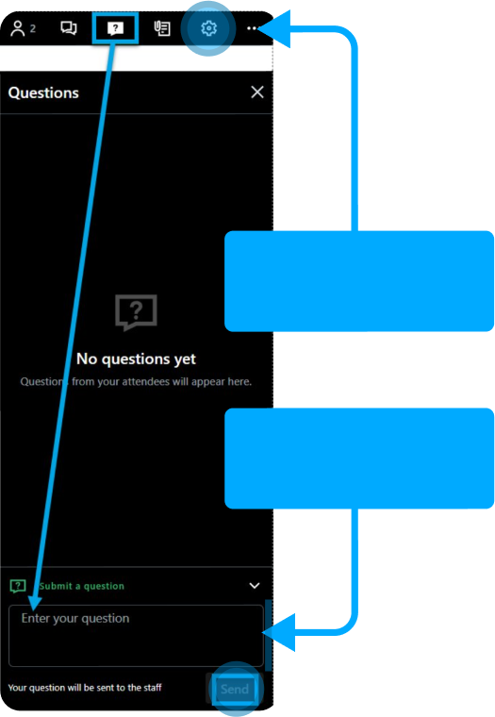

Questions During the Presentation​
1
Adjust
audio settings
2
or
Webinar Control
Panel Desktop
info@dlubal.com
Ask question
Webinar

Slide 4



Content
1
Problem statement
2
Procedure
3
Evaluation of results

Slide 5




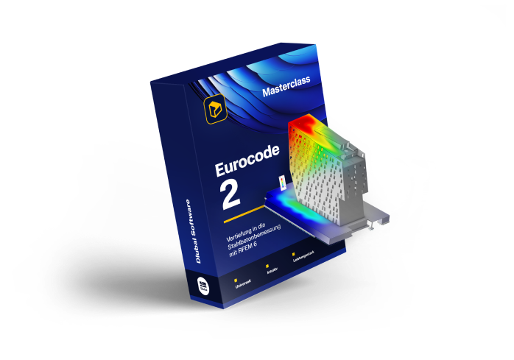
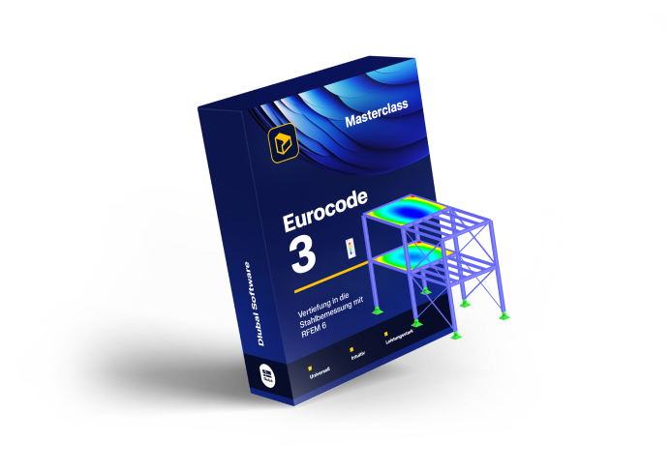
Online Courses
RFEM⁶
Masterclass
Eurocode 2
Masterclass
Eurocode 3
Masterclass
All you need to know for a start!
Dive in Reinforced Concrete Design with RFEM 6!
Deep Dive in Steel Design with RFEM 6!
Go to course
Go to course
Go to course

Slide 6



Online Courses
Eurocode 5
Masterclass
Eurocode 8
Masterclass
AI
Masterclass
Deep Dive in Timber Design
with RFEM 6!
Deep Dive into Earthquake Design with RFEM 6!
Ensuring Safe and Compliant Use of Artificial Intelligence!
Go to course
Go to course
Go to course

Slide 7


Submit your customer
project and receive
a free online course!
For each published project, you will receive a voucher for an Online Course on RFEM 6, Eurocode 2, Eurocode 3, Eurocode 5, or Eurocode 8, valued at 199 - 399€.
Submit your Project

Slide 8

Free Online Services
DLUBAL COMMUNITY
90-Day Full Trial Version Download
GEO ZONE TOOL
Experience the full power of our structural analysis and design software with a free 90-day trial. Get access to all programs and add-ons without restrictions.
CROSS-SECTION PROPERTIES
3D MODELS TO DOWNLOAD
Explore All Our Services

Slide 9




Get Further Details
About Dlubal​
Videos and recorded webinars
Newsletters
Events and conferences
Knowledge Base Articles
90-Day
MIA AI Assistent
Download 90-Day Full Trial Version
Full Free Trial
www.dlubal.com
Dlubal Software GmbH​
Am Zellweg 2
93464 Tiefenbach, Germany
+49 9673 9203-0​
info@dlubal.com​
Visit www.dlubal.com

Slide 10
Thank You for Your
Attention
Webinar

