Slide 1
Structural Analysis & Design Software

Slide 2
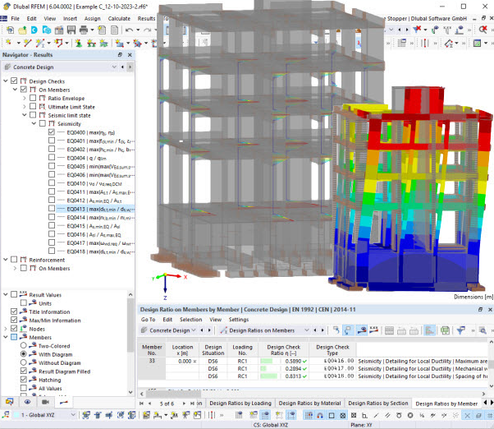
Seismic Design of Reinforced Concrete Structures in RFEM 6
Dipl.-Ing. (FH) Andreas Hörold
Organizer
Marketing & Public Relations Dlubal Software GmbH
Webinar
Dipl.-Ing. Juliane Stopper-Akdag
Co-Organizer
Product Engineering & Customer Support Dlubal Software GmbH
Dipl.-Ing. (FH) Alexander Meierhofer
Co-Organizer
Head of Product Engineering Concrete & Customer Support Dlubal Software GmbH

Slide 3
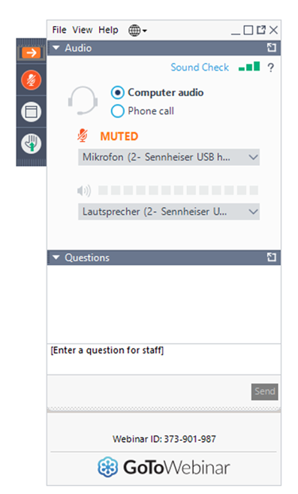
Questions During the Presentation
Show or hide control panel
Adjust audio settings
GoToWebinar Control Panel
Desktop
E-mail: info@dlubal.com
Webinar
Ask questions

Slide 4
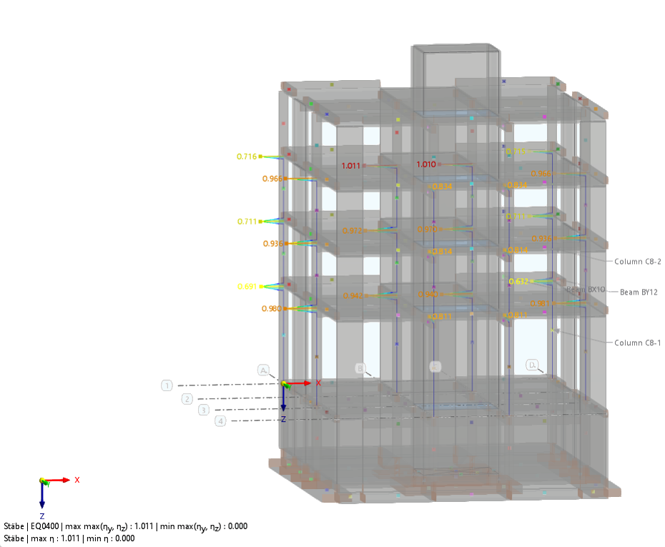
CONTENT
01
Presentation of model and loading
02
Modeling of design objects
03
Design of reinforced concrete structure according to EC 8
Webinar
04
Prospects

Slide 5
Design process
01
Introduction
Determination of the design parameters
Conceptual design and preliminary member sizing
Analysis and design acc. to EC 2
Seismic analysis acc. to EC 8, clause 4
Ultimate limit state design
Capacity design acc. to EC 8, clause 5
Webinars provided on Dlubal website
Webinar
Webinars provided on Dlubal website
Content of current webinar

Slide 6
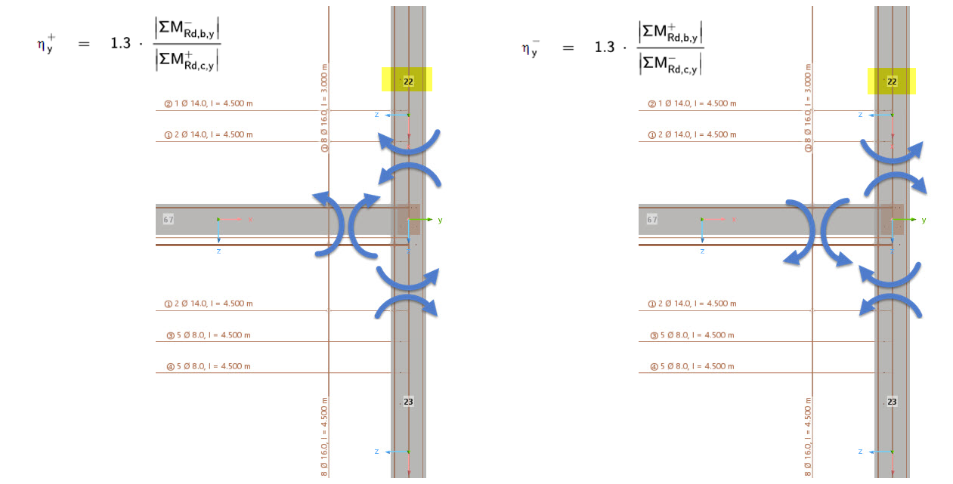
Capacity design
03
Design of reinforced concrete structure according to EC 8
Ratio between Moment resistances acc. to eq. (4.29) - “Strong column – weak beam“
Webinar

Slide 7
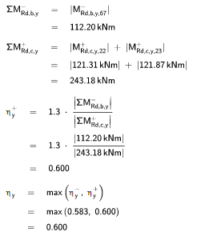
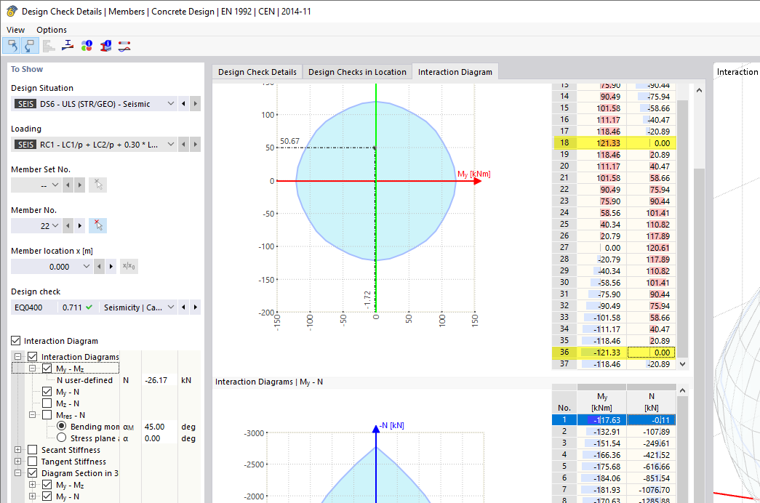
Capacity design
03
Design of reinforced concrete structure according to EC 8
Ratio between Moment resistances acc. to eq.(4.29) - “Strong column – weak beam“
Webinar

Slide 8
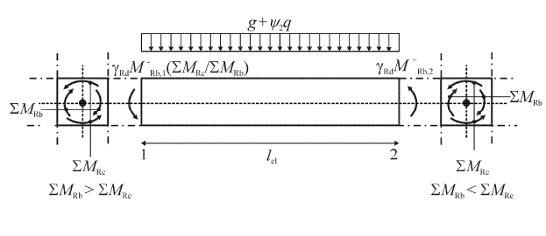
Capacity design
03
Design of reinforced concrete structure according to EC 8
Capacity design shear
Webinar
[DIN EN 1998-1:2010-12]

Slide 9
Links
Webinar reinforced concrete design in RFEM 6 und RSTAB 9
Seismic Design According to Eurocode 8 in RFEM 6 and RSTAB 9
Seismic Load Maps
https://www.dlubal.com/en/support-and-learning/learning/webinars/002636
https://www.dlubal.com/en/support-and-learning/learning/webinars/002783
https://www.dlubal.com/en/support-and-learning/learning/webinars/002705
https://www.dlubal.com/en/solutions/online-services/snow-load-wind-speed-and-seismic-load-maps
Webinar

Slide 10
Book your free Online Appointment!
Dlubal Software
Get valuable insights from one of our experts
Dipl.-Ing. (FH) Dipl.-Wirtschaftsing. (FH) Christian Stautner
Bastian Ackermann, M.Sc.
Daniel Dlubal, M.Sc.
Sales
COO of Dlubal Software GmbH
Head of Sales
Contact Our Sales Team

Slide 11
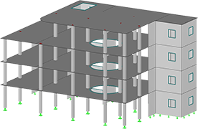
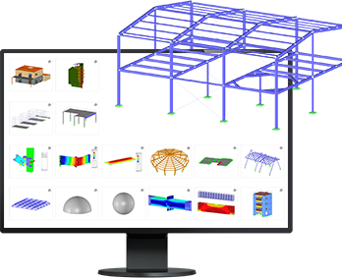
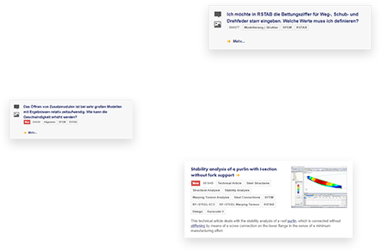
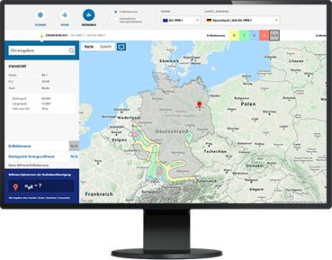
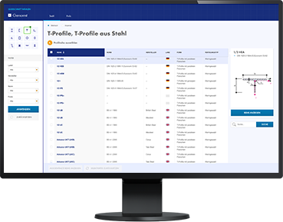
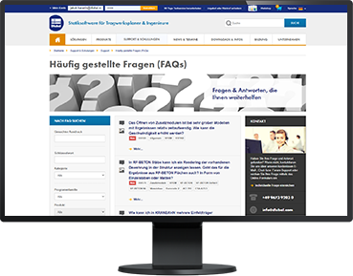
Free Online Services
Dlubal Software
Cross-Section Properties
FAQs & Knowledge Base
Models to Download
Geo-Zone Tool
Dlubal Software provides an online tool with snow, wind and seismic zone maps.
With this free online tool, you can select standardized sections from an extensive section library, define parametrized cross-sections and calculate its cross-section properties.
Access frequently asked questions commonly submitted to our customer support team and view helpful tips and tricks articles to improve your work.
Download numerous example files here that will help you to get started and become familiar with the Dlubal programs.
Webinar

Slide 12
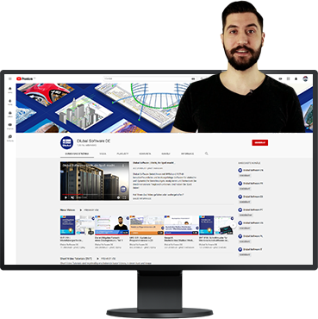
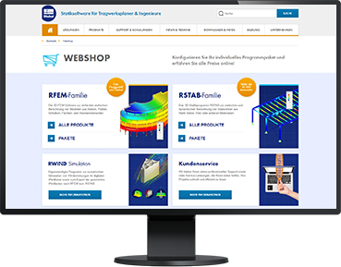
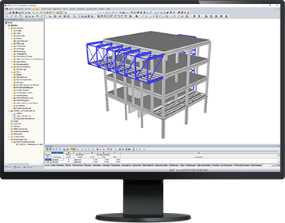
Free Online Services
Dlubal Software
We offer free support via email and chat
Youtube Channel - Webinars, Videos
Webshop with Prices
Trial Licenses
Videos and webinars about the structural engineering software.
Configure your individual program package and get all prices online!
The best way how to learn using our programs is to simply test them for yourself. Download a 90-day free trial version of our structural analysis & design software.
Webinar
90-DAY FREE TRIAL

Slide 13
Get Further Details About Dlubal
Videos and recorded webinars
Newsletters
Events and conferences
Knowledge Base articles
See Dlubal
Software in action in a webinar
Download free trial license
Visit website
www.dlubal.com
Dlubal Software GmbH
Am Zellweg 2,
93464 Tiefenbach, Germany
Phone: +49 9673 9203-0
E-mail: info@dlubal.com

Slide 14
www.dlubal.com

